Slide 1
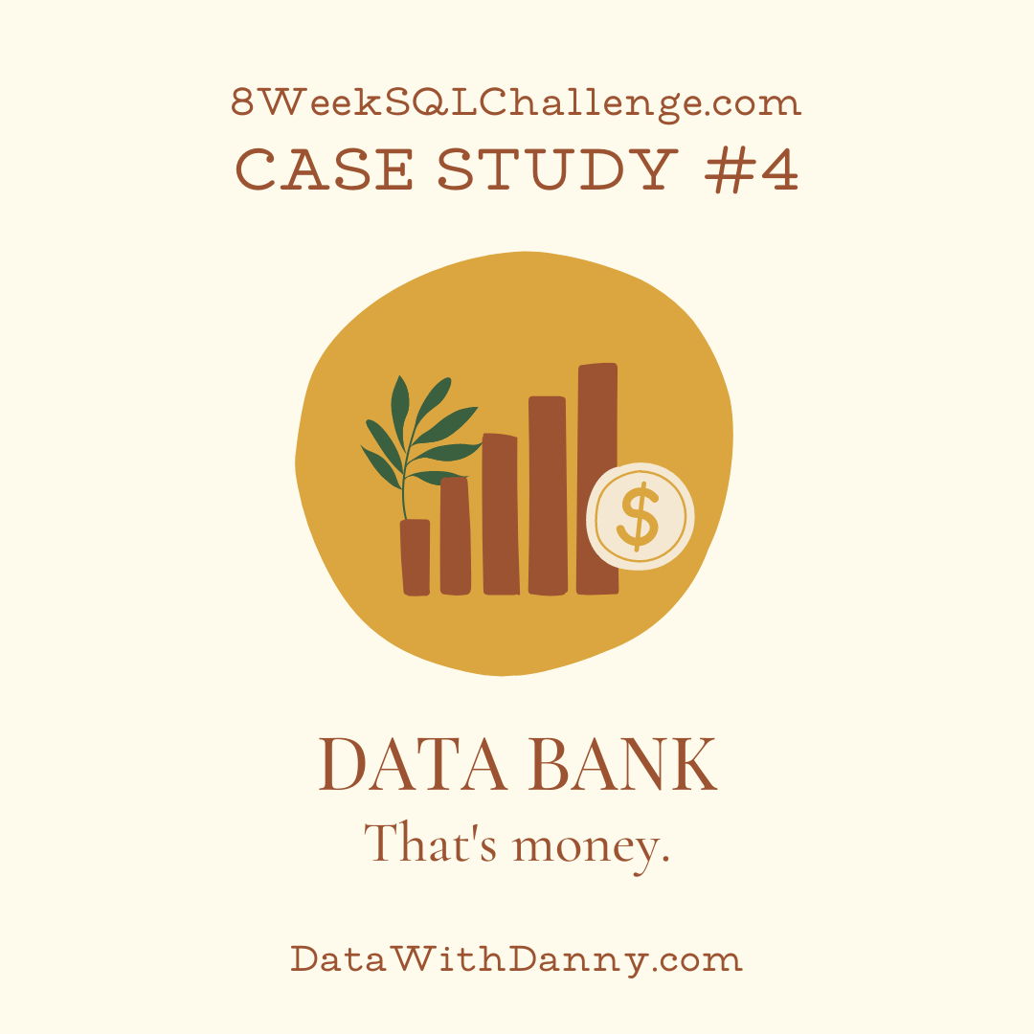
8 Week SQL Challenge
Case Study #4 Data Bank

Slide 2
Introduction
There is a new innovation in the financial industry called Neo-Banks: new aged digital only banks without physical branches.
Danny thought that there should be some sort of intersection between these new age banks, cryptocurrency and the data world…so he decides to launch a new initiative - Data Bank!
Data Bank runs just like any other digital bank - but it isn’t only for banking activities, they also have the world’s most secure distributed data storage platform!
Customers are allocated cloud data storage limits which are directly linked to how much money they have in their accounts. There are a few interesting caveats that go with this business model, and this is where the Data Bank team need your help!
The management team at Data Bank want to increase their total customer base - but also need some help tracking just how much data storage their customers will need.
This case study is all about calculating metrics, growth and helping the business analyze their data in a smart way to better forecast and plan for their future developments!

Slide 3
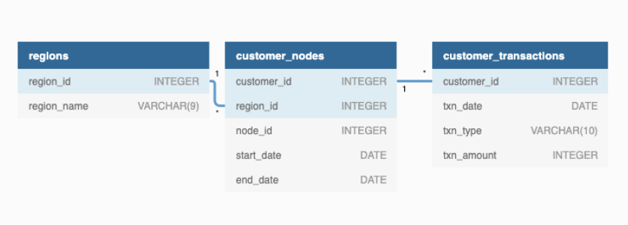
Entity Relationship Diagram

Slide 4
A. Customer Nodes Exploration
How many unique nodes are there on the Data Bank system?
What is the number of nodes per region?
How many customers are allocated to each region?
How many days on average are customers reallocated to a different node?
What is the median, 80th and 95th percentile for this same reallocation days metric for each region?

Slide 5
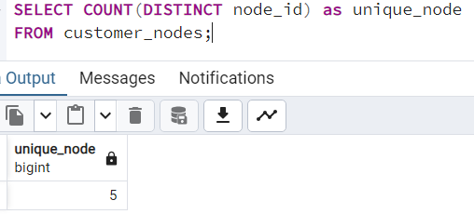
1. How many unique nodes are there on the Data Bank system?
There are 5 Unique nodes present in Data Bank System

Slide 6
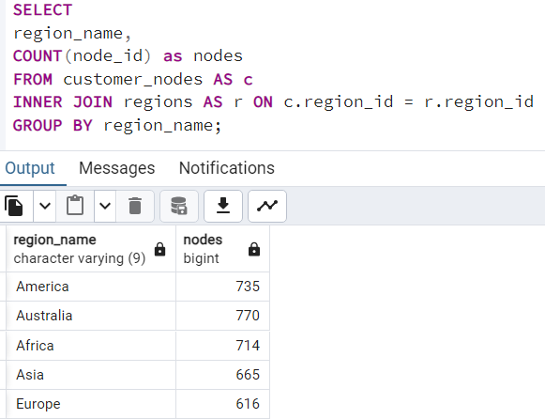
2. What is the number of nodes per region?

Slide 7
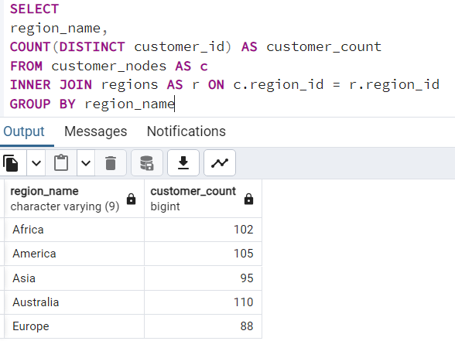
3. How many customers are allocated to each region?

Slide 8
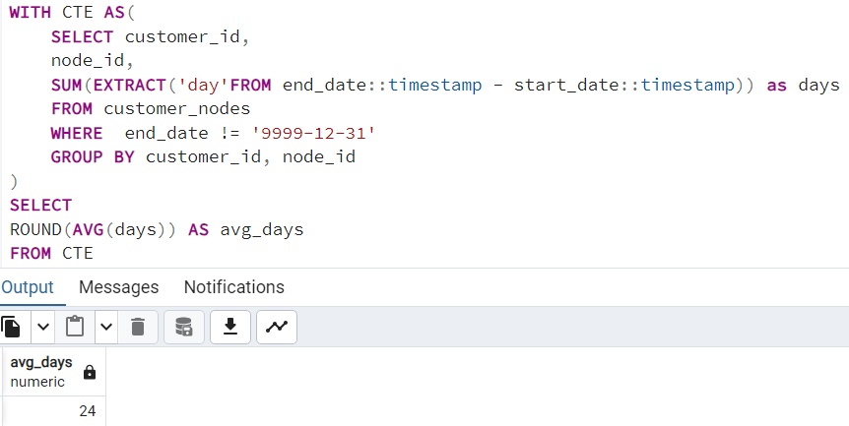
4. How many days on average are customers reallocated to a different node?
On an Average each customer spent 24 days to reallocate to a different node.

Slide 9
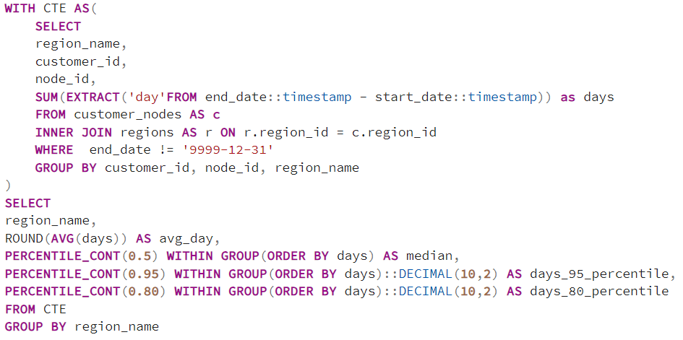
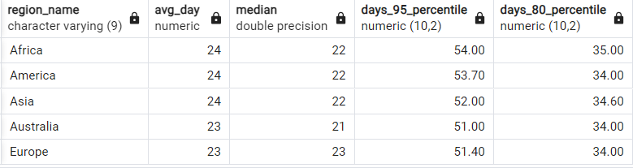
5. What is the median, 80th and 95th percentile for this same reallocation days metric for each region?

Slide 10
B. Customer Transactions
What is the unique count and total amount for each transaction type?
What is the average total historical deposit counts and amounts for all customers?
For each month - how many Data Bank customers make more than 1 deposit and either 1 purchase or 1 withdrawal in a single month?
What is the closing balance for each customer at the end of the month?

Slide 11
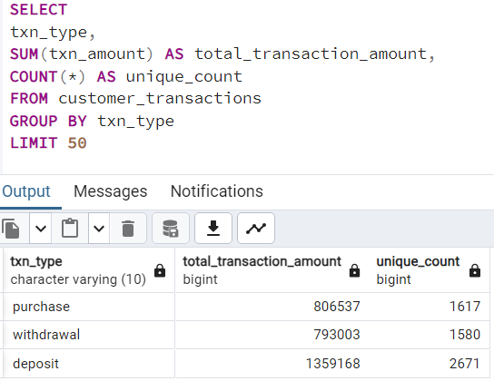
1. What is the unique count and total amount for each transaction type?

Slide 12
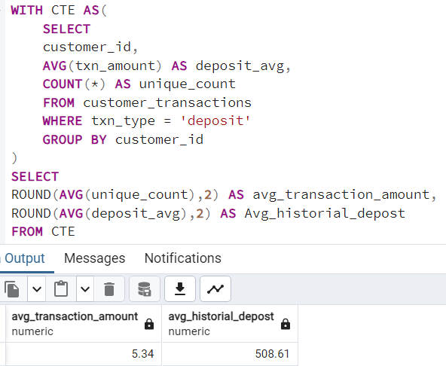
2. What is the average total historical deposit counts and amounts for all customers?

Slide 13
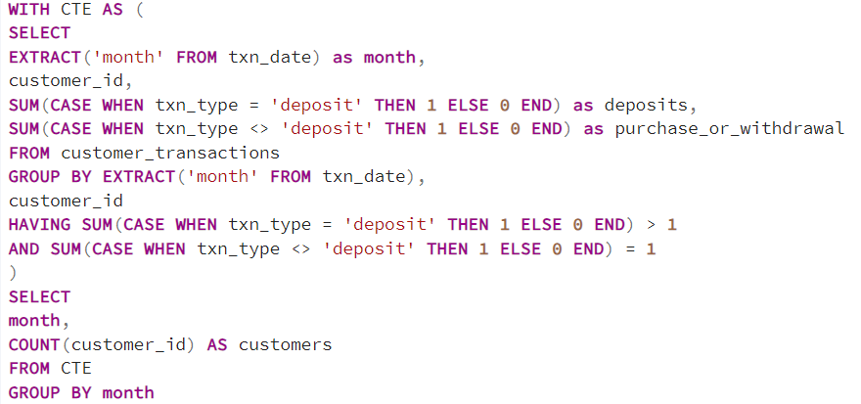
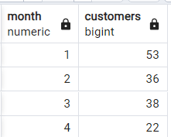
3. For each month - how many Data Bank customers make more than 1 deposit and either 1 purchase or 1 withdrawal in a single month?

Slide 14
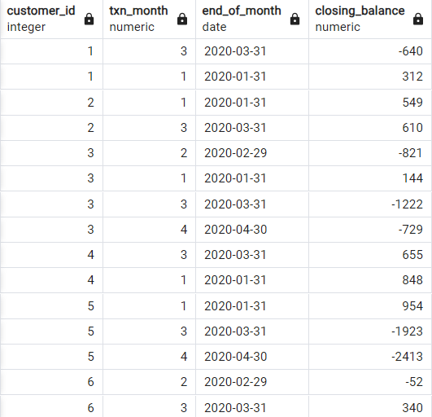
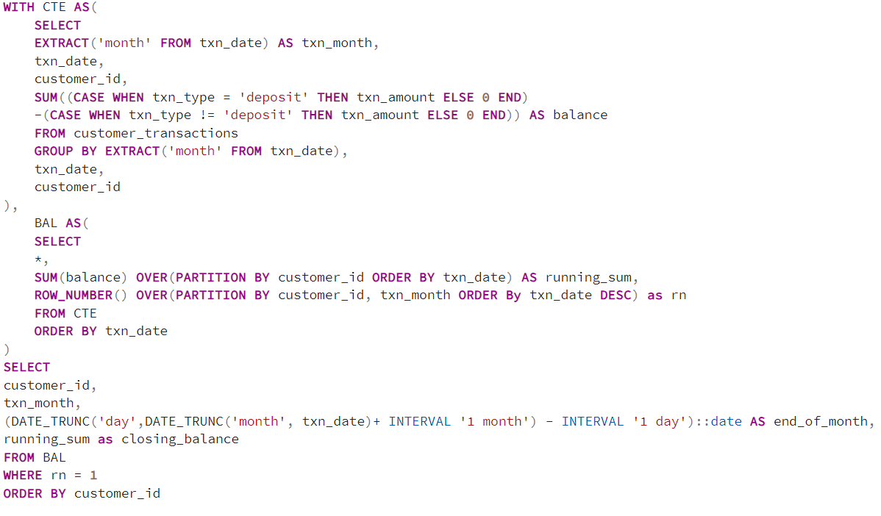
4. What is the closing balance for each customer at the end of the month?

